Slide 1
Module 4: Azure Machine Learning Remote Compute

Slide 2
Azure Machine Learning Remote Compute

Slide 3
Data Science Building Blocks Project
Prepare data, train models
Hyperparameter tuning
Experimentation and pipelines
Deployment
Monitor and Retrain
Classical ML
Deep learning
Data
Data stores
Data sets
Managed Compute
Azure Machine Learning compute cluster

Slide 4
Data Science Building Blocks Project
Prepare data, train models
Hyperparameter tuning
Experimentation and pipelines
Deployment
Monitor and Retrain
Classical ML
Deep learning
Data
Data stores
Data sets
Managed Compute
Azure Machine Learning compute cluster

Slide 5
Data Science Building Blocks Project
Prepare data, train models
Hyperparameter tuning
Experimentation and pipelines
Deployment
Monitor and Retrain
Classical ML
Deep learning
Data
Data stores
Data sets
Managed Compute
Azure Machine Learning compute cluster

Slide 6
Wide choice of hardware
CPUs
GPUs
FPGAs
General purpose machine learning
D, F, L, M, H Series
Deep learning
N Series
Specialized hardware accelerated deep learning
Project Brainwave
Optimized for flexibility
Optimized for performance
FPGA NEW UPDATES:
Support for image classification and recognition scenarios
ResNet 50, ResNet 152, VGG-16, SSD-VGG, DenseNet-121
Notes:
We have the most comprehensive AI infrastructure
From general purpose CPUs to specialized HW (FPGAs)
FPGA -> lowest cost inferencing. Lower than Google’s TPUs
Most comprehensive set of GPU options so customers can choose the right one for their project. (best price/performance)
<Transition> Let me move to the last part of our ML portfolio.

Slide 7
Azure ML Artifact
Compute Target
Currently supported compute targets
Compute Target | Training | Deployment
Local Computer | ✓
A Linux VM in Azure (such as the Data Science Virtual Machine) | ✓
Azure ML Compute | ✓
Azure Databricks | ✓
Azure Data Lake Analytics | ✓
Apache Spark for HDInsight | ✓
Azure Container Instance |  | ✓
Azure Kubernetes Service |  | ✓
Azure IoT Edge |  | ✓
Field-programmable gate array (FPGA) |  | ✓
Compute Targets are the compute resources used to run training scripts or host your model when deployed as a web service.
They can be created and managed using the Azure Machine Learning SDK or CLI.
You can attach to existing resources.
You can start with local runs on your machine, and then scale up and out to other environments.

Slide 8
Azure ML
Currently Supported Compute Targets
Compute target | GPU acceleration | Hyperdrive | Automated model selection | Can be used in pipelines
Local computer | Maybe |  | ✓
Data Science Virtual Machine (DSVM) | ✓ | ✓ | ✓ | ✓
Azure ML compute | ✓ | ✓ | ✓ | ✓
Azure Databricks | ✓ |  | ✓ | ✓
Azure Data Lake Analytics |  |  |  | ✓
Azure HDInsight |  |  |  | ✓
https://docs.microsoft.com/en-us/azure/machine-learning/service/how-to-set-up-training-targets#supported-compute-targets
Notes:
Azure Databricks and Azure Data Lake Analytics can only be used in a pipeline.
You cannot attach an existing Azure Containers Instance to your workspace. Instead, you must create a new instance.
You cannot create Azure HDInsight, Azure Databricks, or Azure Data Lake Store within a workspace. Instead, you must create the resource and then attach it to your workspace.

Slide 9
Demo: hyperparameter tuning with Azure ML

Slide 10
Lab_04: Hyperparameter tuning with Azure ML

Slide 11
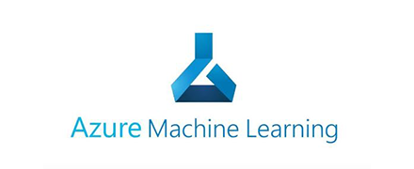
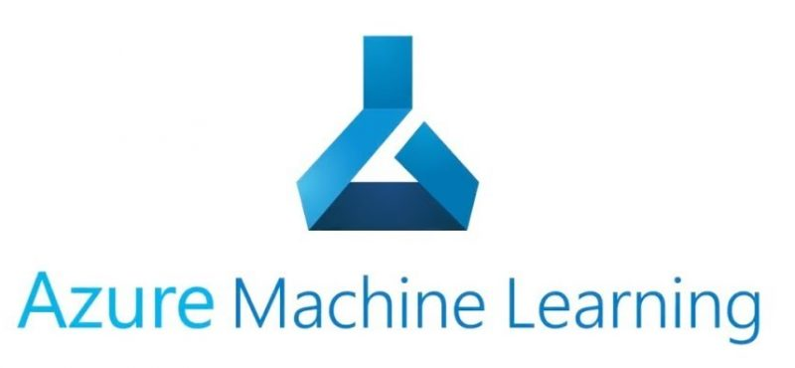
train.py
Conda_dependencies.yml
Azure Managed Compute
Training script
Environment
Compute
train_sumit.py
Hyperdrive Run configuration
Search grid
logs
Experiment
Submit run
Parent run
Child runs

